Slide 1
Unit 6 – Business Finance and Accounting
Cash Flow Planning

Slide 2
Aims
Explain the importance of cash
Construct and interpret a simple cash flow forecast
Explain the concept and function of profit
Distinguish between cash and profit

Slide 3
Cash and cash flow
Cash is money. It is a liquid asset, meaning that it is immediately available for spending.
Cash flow is the movement of money into and out of a business
Inflow (cash in) | Outflow (cash out)

Slide 4
Cash Flow Cycle
Cash needed to pay for…
Materials, rent, wages etc.
Goods produced
Goods sold
Cash received for goods sold

Slide 5
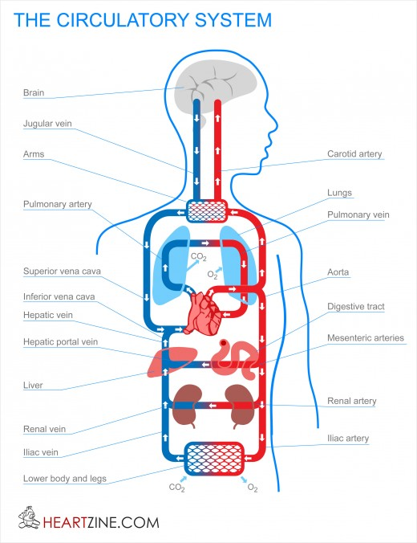
The importance of cash
Cash is the ‘lifeblood’ of the business
If cash stops flowing, the business cannot continue, even if future sales/profits are expected
Businesses need to make sure that they plan their cash flow so that cash inflows equal or exceed cash outflows

Slide 6
Cash and profit
Cash is not the same as profit. Profit is the cash surplus left over after all costs have been subtracted from sales revenue.
i.e. Profit = Sales Revenue – Total Costs.
Look at the example on page 127
Complete activity 8.2 (page 128)

Slide 7
Cash Flow Forecasts
This is a month-by-month estimate of future cash inflows and outflows of a business. It can be used to tell a business…
How much cash is available for capital or revenue expenditure
How much cash might need to be borrowed to continue operating
Whether the business is holding too much cash that might be invested to earn more revenue

Slide 8
Cash Flow Forecasts

Slide 10
Activities
8.3
8.4
Read page 131 (How can cash flow problems be solved?) and complete the spidergram

Slide 11
Cash Flow Forecasts
Activity 8.3 part a
$2,000
$4,000
$22,000

Slide 12
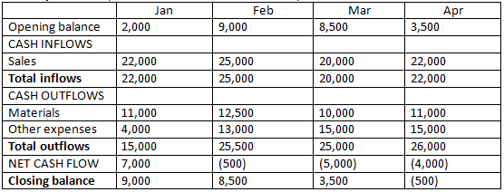
Cash Flow Forecasts
Activity 8.4

Slide 13
Solving cash flow problems
Solutions?
Notes:
Overdraft agreement
Reduce/delay expenses or increase credit periods with suppliers
Increase income (sales, training, hours, selling assets)

Slide 14
Today
Complete worksheet WF2.1 (introduction to cash flow)
Complete the multi-choice quiz (open book)
Extension
Complete worksheet WF2.2 (Makeum and Useum Ltd.)

