Slide 1
Unit 6 – Business Finance and Accounting
Business Accounting

Slide 2
Aims
Explain the meaning of accounts, and understand why businesses need to keep them
Explain the interests of various users of business accounts

Slide 3
Accounts
Accounts are the financial records of a firm’s transactions. FINAL accounts are prepared at the end of a financial year and give details of the financial performance of the business.
To create these accounts, accountants need to record business transactions and activities using a number of financial documents…

Slide 4
Financial documents
Read the information in the case study on pages 106-8 and match the correct description to the terms in the table on your worksheet

Slide 5
Payment methods
Businesses can take payment for goods and services in several ways – a range of accepted/supported methods ensures customer satisfaction.

Slide 6
Activities
Read page 109 and answer revision question 1
Complete the activities from previous lessons…
Use the answers at the back of the textbook and the back tables to self-assess.
Textbook
8.3 and 8.4 (p.130)
9.5 (143)
9.6 (145)
Cashflow Worksheets
2.1 (introduction)
2.2 (makeum and useum)
Quizes
Financing business activity
Cash flow

Slide 7
Unit 6 – Business Finance and Accounting
Trading, Profit and Loss Account

Slide 8
Trading, Profit and Loss Account
Trading Account – shows how the difference between the cost of goods sold and what they we sold for
Gross Profit – sales revenue minus cost of sales
Cost of Sales – the cost of producing or buying goods sold by the business during a period of time. Opening stock plus purchases minus closing stock

Slide 9
Trading Account
e.g. if a shop bought $50,000 of goods during the year and sold them for $75,000, the gross profit would be $25,000
Gross Profit = Sales Revenue – Cost of Sales
Gross profit is not the final profit for the business – overheads and expenses are not deducted yet.

Slide 10
Trading Account
Cost of sales does not JUST include good purchased. There will be goods left from the last time period (opening stock) and goods left over for the next period (closing stock).
Cost of Sales = Opening Stock + Purchases – Closing Stock

Slide 11
Trading Account
In summary…
Gross Profit = Sales Revenue – Cost of Sales
Sales Revenue = number sold x price
Cost of Sales = Opening Stock + Purchases – Closing Stock

Slide 12
Have a go…
Complete activities…
7.1
7.2
Notes:
7.1 a=1,500; b=9,000; c=60,000; d=75,000
7.2 b=11,000; c=1,000; d=60,000

Slide 13
Profit and Loss Account
This shows how the ‘net profit’ is calculated to determine the final profit of the business after all expenses have been deducted.
Net Profit = Gross Profit – Expenses/Overheads
Look at the example on page 112

Slide 14
Appropriation Account
This final part of the Trading Profit and Loss Account shows what the company has done with the profits it made during the time period.
Profits can be…
Distributed to shareholders in the form of dividends
Retained for future use
Look at the example on page 113

Slide 15
Trading, Profit and Loss Account
Complete the following activities…
Worksheet 3.1 (Introduction to profit and loss)
Worksheet 3.2 (Makeum and Useum Ltd.)
Notes:
Rev 280
COS 100
GP 180
Expenses 30
Profit BT 150
Tax 40
Interest 15
NP 95
Div 25
RP 70

Slide 16
Unit 6 – Business Finance and Accounting
Balance Sheet

Slide 17
Balance Sheets
This account shows how much a business is worth at a particular point in time.
‘Worth’ is worked out by calculating the value of the assets and liabilities of a business…
Liabilities – the money that has been borrowed or invested by a business to buy assets.
Assets – the items that the money raised has been spent on

Slide 18
Assets
Assets can either be:
‘fixed’ (long term, that are likely to be kept in the business for more than 1 year) or
‘current’ (short term, that are likely to be held by the business for 1 year or less)

Slide 19
Examples?
FIXED ASSETS | CURRENT ASSETS

Slide 20
Assets in the Balance Sheet

Slide 21
Liabilities
Liabilities can either be…
Current (money that the business owes back within 1 year)
Non-current (money that a business owes back in 1 year or more)
Current Liabilities | Non-Current Liabilities
Bank overdraft
Bank loan
Creditors
Share capital
Interest on borrowed finance

Slide 22
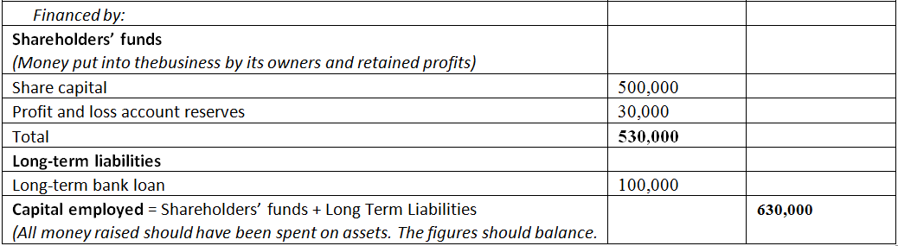
Liabilities in the Balance Sheet

Slide 23
Task
Complete the balance sheet for Makeum and Useum Ltd using the information provided.
Extension – write your thoughts/comments about the financial position of the business underneath.

Slide 24
Key principle of a balance sheet
all assets
must equal
all liabilities
Which means that:
where money has been spent
where money came from
must equal
Notes:
It is essential that businesses account for exactly how all money borrowed has been spent. If a company is unable to balance where their money has been spent with where their money has come from, they will inevitably get into financial difficulty. In addition, the information in a balance sheet is of particular interest to those who have invested in the business, for example shareholders. They will want to know exactly how their money has been spent and will doubtless question any discrepancies which arise.

