Slide 1
Unit 6 – Business Finance and Accounting
Financial Analysis

Slide 2
Aims
Interpret the performance of a business by using simple accounting ratios.
Recommend possible solutions to improving business financial performance

Slide 3
Freshfoods and Foodstore PLC
Look at the case study on page 118.
Think about the bullet-point questions and be prepared to explain your thoughts…

Slide 4
Financial Analysis
Financial performance and strength cannot be judged by looking at standalone figures.
Ratio analysis involves comparing figures over time, between different businesses in an industry or simply between different sections of the accounts.

Slide 5
Performance Ratios
Return on Capital Employed (RoCE)
Net/Operating Profit x100%
Capital Employed
Page 119
The higher the result, the more successful the business is at earning profit from the money used in the business

Slide 6
Performance Ratios
Gross Profit Margin
Gross Profit x100%
Sales Revenue
Page 120
Shows how much profit is earned through sales on every $ spent producing each unit – the higher the better
Can increase if price increases or if costs decrease

Slide 7
Performance Ratios
Net Profit Margin
Net Profit x100%
Sales Revenue
Page 120
Shows how much profit is earned through sales on every $ spent on producing each unit AND running the business as a whole (overheads)
Can increase if price increases or if costs decrease

Slide 8
Activities
Page 124, question 12
Notes:
120
RoCE = 195/1160 = 16.8%
GPM = 350/1250 = 28%
NPM = 195/1250 = 15.6%
124 (2004)
RoCE = 9/70 12.8%
GPM = 15%
NPM = 9%
2005
RoCE = 8.75% down
GPM = 13.3% down
NPM = 5.8% down

Slide 9
Notes:
2004
RoCE = 25/300 = 8.3%
GPM = 20%
NPM = 12.5%
2005
RoCE = 5%
GPM = 12.8%
NPM = 6%

Slide 10
Liquidity Ratios
These measure the ability of a business to pay back its short-term debts. If it can, it is said to be liquid and there is less risk that it will run out of cash to continue.
Current Ratio
Current Assets
Current Liabilities
Expressed as a ratio = ?:1
e.g. 200/100 = 2:1. For every $1 of money owed, the business has $2 to cover/pay it. If it had to, it would be left with $2 to continue operating. Businesses aim for between 1.5 and 2 :1
Page 121

Slide 11
Liquidity Ratios
The current ratio assumes that ALL stock (a current asset) will be sold, which may not always happen.
Acid Test Ratio
Current Assets - Stock
Current Liabilities
Expressed as a ratio = ?:1
e.g. 200-125/100 = 0.75:1. For every $1 of money owed, the business only has $0.75 to cover/pay it. It would not be able to cover the debt, and would certainly run out of cash to continue.
Page 121

Slide 12
Improving liquidity
Increase cash inflow
Increase sales
Raise price (for inelastic products)
Chase debtors
Reduce cash outflow
Reduce costs (cheaper suppliers, premises etc.)
Delay payments to creditors (credit agreements)

Slide 13
Activities
Page 121, activity 7.7 parts a) and b)
Page 124, question 16
Notes:
Q16
2004 = 1.13:1
2005 = 0.6:1
P121
Current = 1.07:1
Acid test = 0.46:1

Slide 14
Evaluation
Helps stakeholders better understand the financial performance of the business
May make it easier to obtain finance or attract shareholders
Often encourages managers to run the business better.
Ratios are based on past results – no guarantee of future performance
Using data from too far in the past will be misleading as the value of money has changed (inflation)
Difficult to compare between businesses as they may use slightly different calculations in their accounts

Slide 15
Past Exam Questions
Paper 1 | Paper 2
June 2013, Paper 13, Question 2 a), b) and e) Jun ‘13, P12, Q4 a, b, c, e Jun ‘13, P11, Q4 b, e Nov ‘12, P13, Q2 a, b, c, d, e Nov ’12, P12, Q3 a, c, d, e Nov’12, P11 Q3 a, b, c, d, e Jun’12, P13, Q3 b, c, d Jun’12, P11 Q4 b, c | June 2013, Paper 23, Question 3 a) and b) Jun ’13, P22, Q3 a, b Jun ‘13, P21, Q3 b Nov ‘12, P21, Q4 b Jun ‘12, P23, Q5 b Jun ‘12, P22, Q1 b and Q3 b

Slide 16
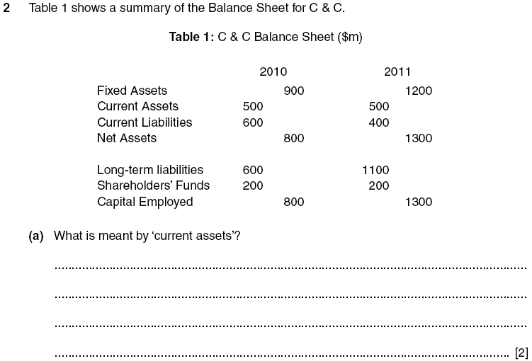
Nov ‘12, P13, Q2

Slide 19
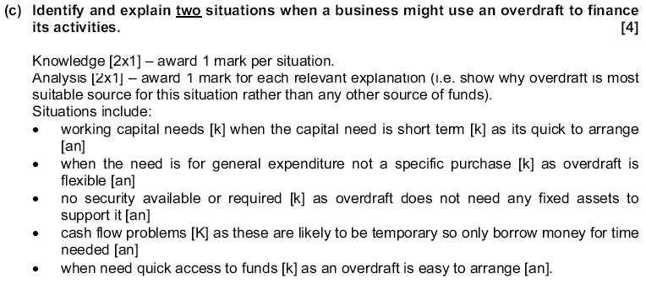

Slide 20
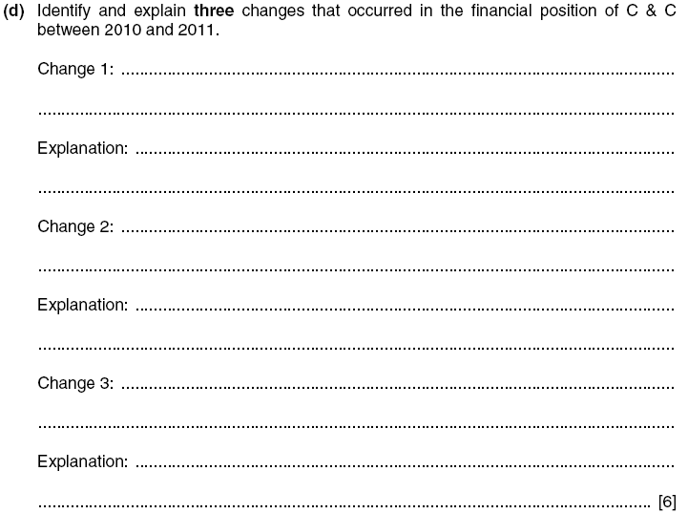
Nov ‘12, P13, Q2

Slide 22
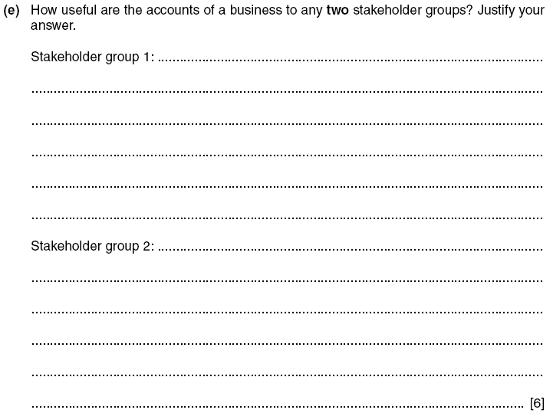
Nov ‘12, P13, Q2

Slide 24
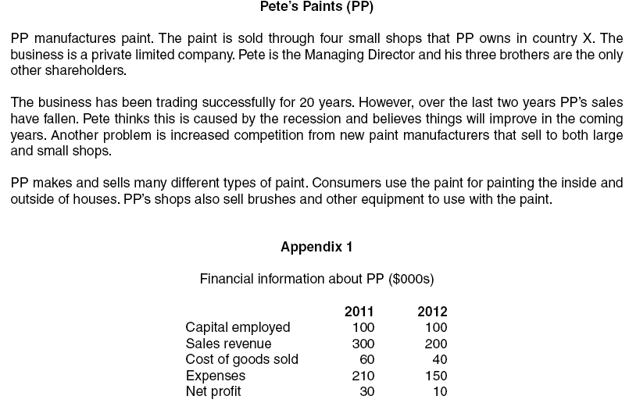
Jun ‘13, P23, Q3

Slide 25
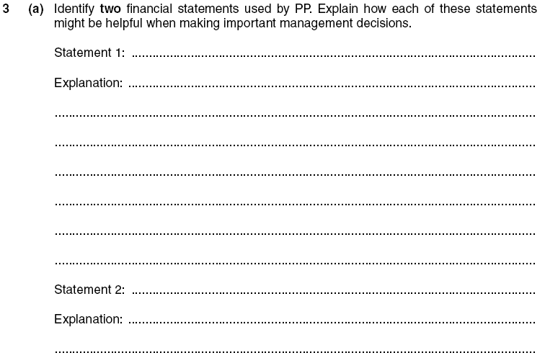
Jun ‘13, P23, Q3

Slide 26
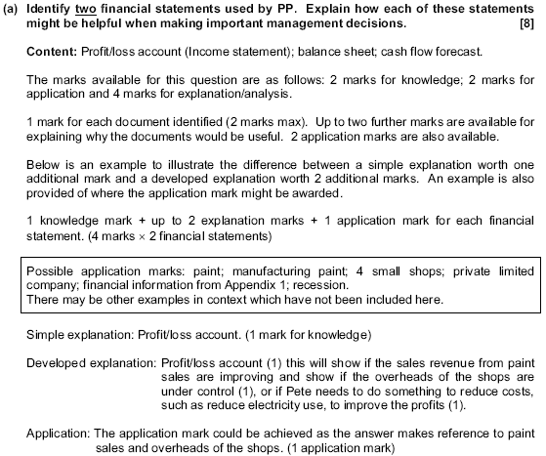

Slide 27
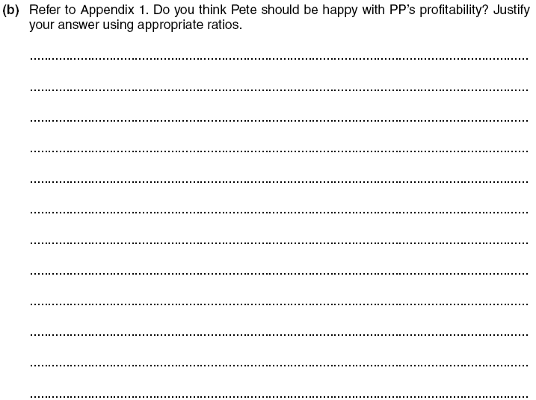
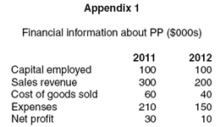
Jun ‘13, P23, Q3

Slide 28
Jun ‘13, P23, Q3

Slide 29
