Slide 1
Unit 6 – Business Finance and Accounting
Revision Day

Slide 2
Aims
Review the main features of the finance topics
Financing business activity
Cash flow planning
Business accounting
Discuss and practice past paper (1 and 2) question strategies
Make you feel more confidant and prepared

Slide 3
Why do businesses need finance?
Notes:
Running costs
Starting up
Expanding
Getting out of difficulty

Slide 4
Financing Business Activity
Some key terms…
Internal/external finance
Assets
Working capital
Capital expenditure
Revenue expenditure

Slide 5
Sources of Finance
INTERNAL EXTERNAL

Slide 6
Finance Timescales
Short term finance (needed for up to 3 years)
Medium term finance (4-10 years)
Long term finance (more than 10 years)

Slide 7
The finance decision
What factors do managers consider before choosing on a source of finance?
Notes:
Purpose and time period
Amount needed
Status and size
Control (shareholders?)
Risk and gearing

Slide 8
Cash Flow Planning
Key Terms
Cash inflow
Cash outflow
Cash flow forecast
Opening/closing balance
Cash flow cycle
Liquidity

Slide 9
Inflows and Outflows
Inflow Outflow

Slide 10
Cash Flow Cycle
Cash needed to pay for…
Materials, rent, wages etc.
Goods produced
Goods sold
Cash received for goods sold

Slide 11
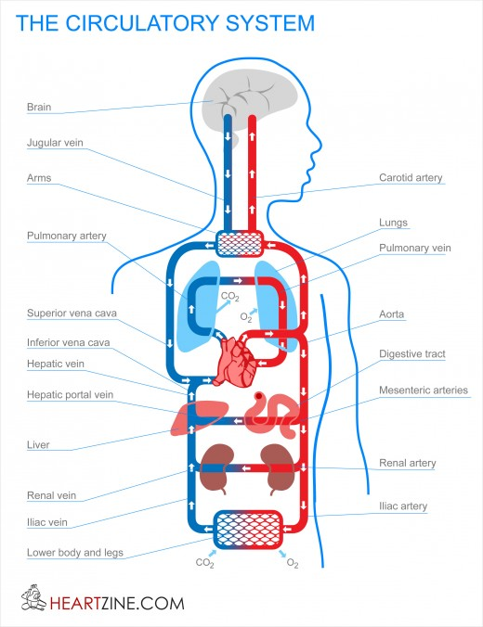
The importance of cash
Cash is the ‘lifeblood’ of the business
If cash stops flowing, the business cannot continue, even if future sales/profits are expected
Businesses need to make sure that they plan their cash flow so that cash inflows equal or exceed cash outflows

Slide 12
Cash Flow Forecasts

Slide 13
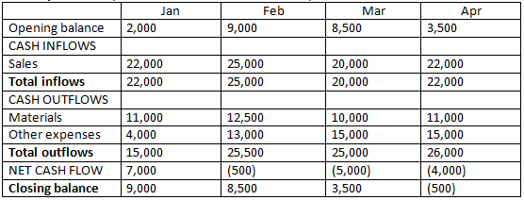
Cash Flow Forecasts

Slide 14
Solving cash flow problems
Solutions?
Notes:
Overdraft agreement
Reduce/delay expenses or increase credit periods with suppliers
Increase income (sales, training, hours, selling assets)

Slide 15
Business Accouting
Key terms
Trading, profit and loss account
Turnover/revenue
Gross/net profit
Corporation tax
Dividends
Depreciation
Balance sheet
Fixed/current assets
Long term/current liabilities
Capital employed

Slide 16
Trading, Profit and Loss Account
Trading Account – shows how the difference between the cost of goods sold and what they we sold for
Gross Profit – sales revenue minus cost of sales
Cost of Sales – the cost of producing or buying goods sold by the business during a period of time. Opening stock plus purchases minus closing stock

Slide 17
The Trading, Profit and Loss Account
 | $’s
Sales turnover | 12,000
Opening Stock | 3000
Purchases | 6000
Closing stock | 1000
Gross Profit | 8000
Overheads | 3000
Net Profit | 5000

Slide 18
Balance Sheets
This account shows how much a business is worth at a particular point in time.
‘Worth’ is worked out by calculating the value of the assets and liabilities of a business…
Liabilities – the money that has been borrowed or invested by a business to buy assets.
Assets – the items that the money raised has been spent on

Slide 19
Assets
Assets can either be:
‘fixed’ (long term, that are likely to be kept in the business for more than 1 year) or
‘current’ (short term, that are likely to be held by the business for 1 year or less)

Slide 20
Assets in the Balance Sheet

Slide 21
Liabilities
Liabilities can either be…
Current (money that the business owes back within 1 year)
Non-current (money that a business owes back in 1 year or more)
Current Liabilities | Non-Current Liabilities
Bank overdraft
Bank loan
Creditors
Share capital
Interest on borrowed finance

Slide 22
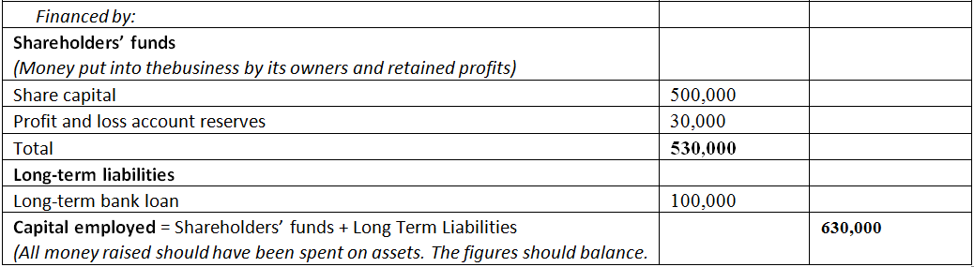
Liabilities in the Balance Sheet

Slide 23
Key principle of a balance sheet
all assets
must equal
all liabilities
Which means that:
where money has been spent
where money came from
must equal
Notes:
It is essential that businesses account for exactly how all money borrowed has been spent. If a company is unable to balance where their money has been spent with where their money has come from, they will inevitably get into financial difficulty. In addition, the information in a balance sheet is of particular interest to those who have invested in the business, for example shareholders. They will want to know exactly how their money has been spent and will doubtless question any discrepancies which arise.

Slide 24
Financial Analysis

Slide 25
Performance Ratios
Return on Capital Employed (RoCE)
Net/Operating Profit x100%
Capital Employed
Page 119
The higher the result, the more successful the business is at earning profit from the money used in the business

Slide 26
Performance Ratios
Gross Profit Margin
Gross Profit x100%
Sales Revenue
Page 120
Shows how much profit is earned through sales on every $ spent producing each unit – the higher the better
Can increase if price increases or if costs decrease

Slide 27
Performance Ratios
Net Profit Margin
Net Profit x100%
Sales Revenue
Page 120
Shows how much profit is earned through sales on every $ spent on producing each unit AND running the business as a whole (overheads)
Can increase if price increases or if costs decrease

Slide 28
Liquidity Ratios
These measure the ability of a business to pay back its short-term debts. If it can, it is said to be liquid and there is less risk that it will run out of cash to continue.
Current Ratio
Current Assets
Current Liabilities
Expressed as a ratio = ?:1
e.g. 200/100 = 2:1. For every $1 of money owed, the business has $2 to cover/pay it. If it had to, it would be left with $2 to continue operating. Businesses aim for between 1.5 and 2 :1
Page 121

Slide 29
Liquidity Ratios
The current ratio assumes that ALL stock (a current asset) will be sold, which may not always happen.
Acid Test Ratio
Current Assets - Stock
Current Liabilities
Expressed as a ratio = ?:1
e.g. 200-125/100 = 0.75:1. For every $1 of money owed, the business only has $0.75 to cover/pay it. It would not be able to cover the debt, and would certainly run out of cash to continue.
Page 121

Slide 30
Improving liquidity
Increase cash inflow
Increase sales
Raise price (for inelastic products)
Chase debtors
Reduce cash outflow
Reduce costs (cheaper suppliers, premises etc.)
Delay payments to creditors (credit agreements)

Slide 31
Evaluation
Helps stakeholders better understand the financial performance of the business
May make it easier to obtain finance or attract shareholders
Often encourages managers to run the business better.
Ratios are based on past results – no guarantee of future performance
Using data from too far in the past will be misleading as the value of money has changed (inflation)
Difficult to compare between businesses as they may use slightly different calculations in their accounts

Slide 32
Exam Technique and Advice

Slide 33
Business Finance Questions
You are very unlikely to be given full accounts – rather ‘financial information’
You are unlikely to have to prepare accounts (though you may have to fill in missing numbers)
You are VERY likely to have to perform ratio analysis based on financial information and compare it with previous years’
You are VERY likely to have to interpret and make recommendations on financial ratio analysis

Slide 34
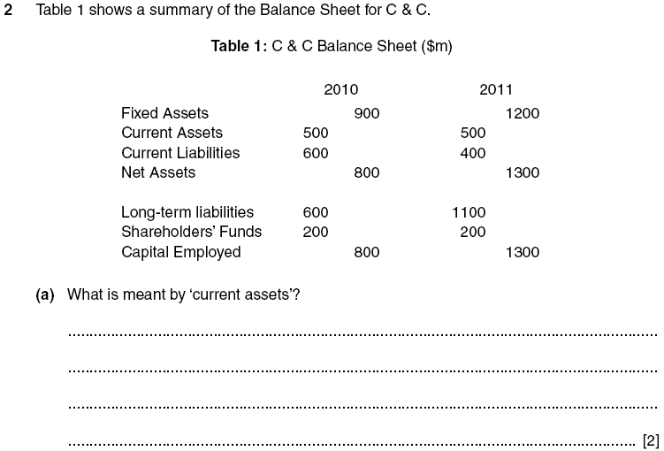
Nov ‘12, P13, Q2

Slide 37
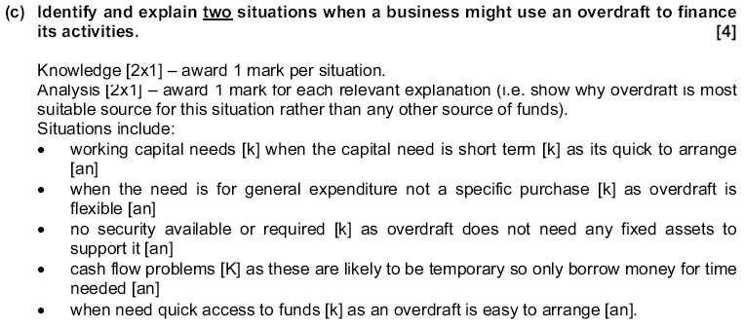

Slide 38
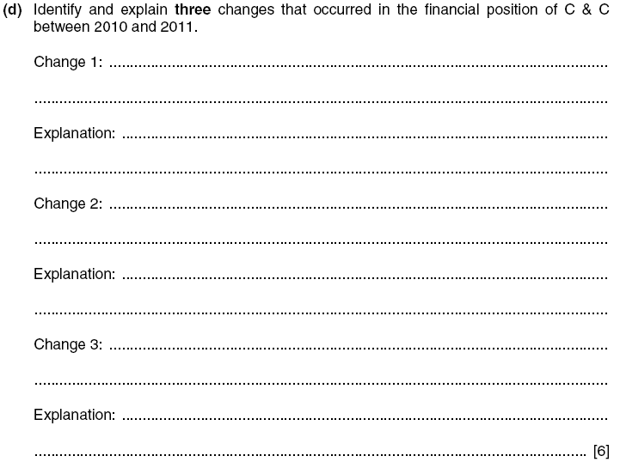
Nov ‘12, P13, Q2

Slide 40
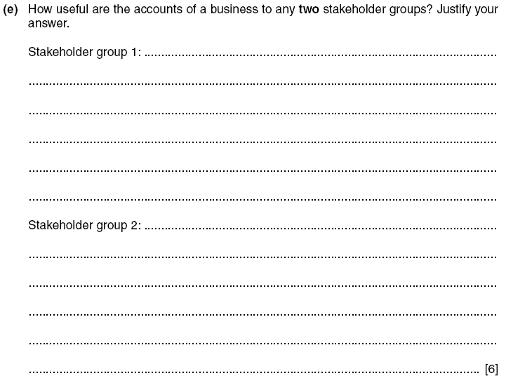
Nov ‘12, P13, Q2

Slide 42
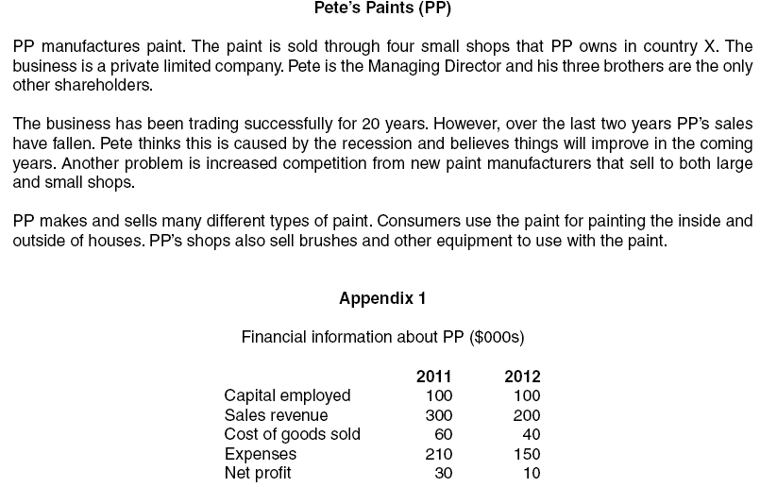
Jun ‘13, P23, Q3

Slide 43
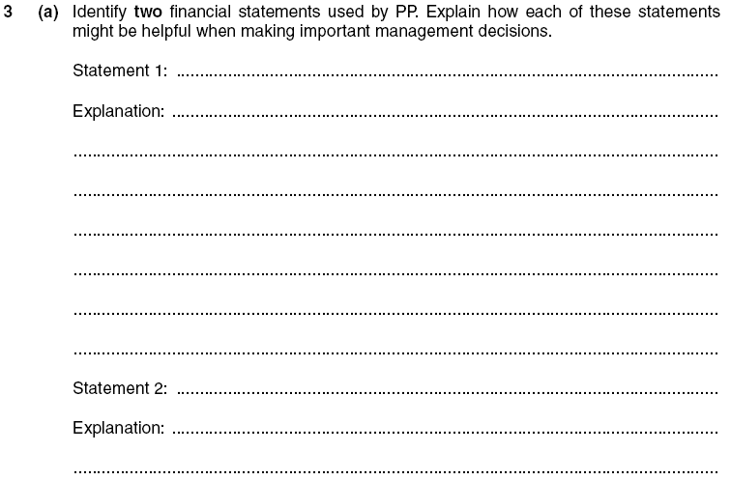
Jun ‘13, P23, Q3

Slide 44
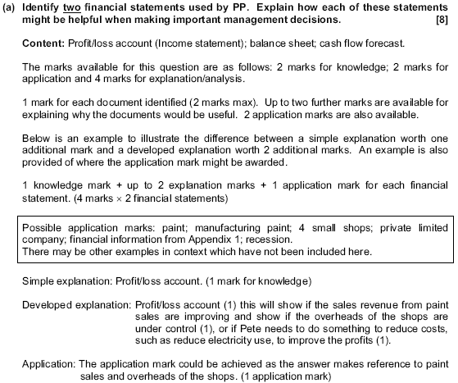

Slide 45
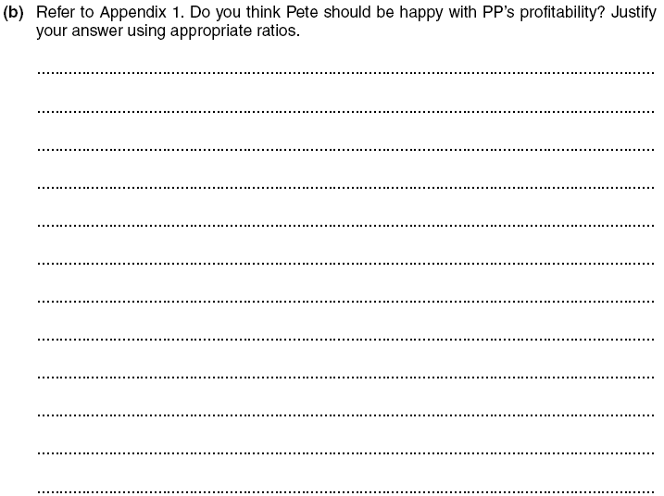
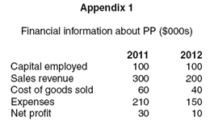
Jun ‘13, P23, Q3

Slide 46
Jun ‘13, P23, Q3

Slide 47
